Slide 1


paris
Our case study
How we did it
Results
Q&A
Term project 2 for Data Engineering 1
Find the correlation between income inequality and various indicators across countries e.g poverty, life expectancy, and education.
LOCATION
Global
DATES
2018
Full Year
DATA
Gini
Education
Poverty
Unemployment
GDP Per Capita
Life expectancy
Explore

Slide 2


Executive summary
paris
The problem
What we did
Solution
Results
We utilised SQL, API and Knime to automate our workflow
We find that:
Higher income countries and European countries have lower income inequality
Poverty rate extremely correlated with income inequality
Unemployment rate and life expectancy can also have significant effect
What is the correlation between income inequality and various socioeconomic indicators such as education, poverty, & life expectancy based on 2018 data for various countries?
We collected data from 3 sources:
Kaggle
World Development Indicator
Eurostat
Data Collection
Data Cleaning
Data Joining
Data Analysis
Data Visualization

Slide 3
WHAT WE DID
paris

Slide 4
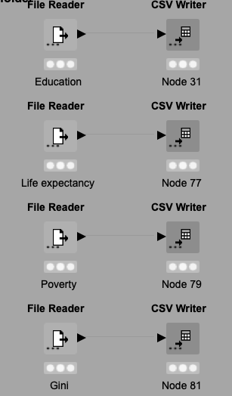
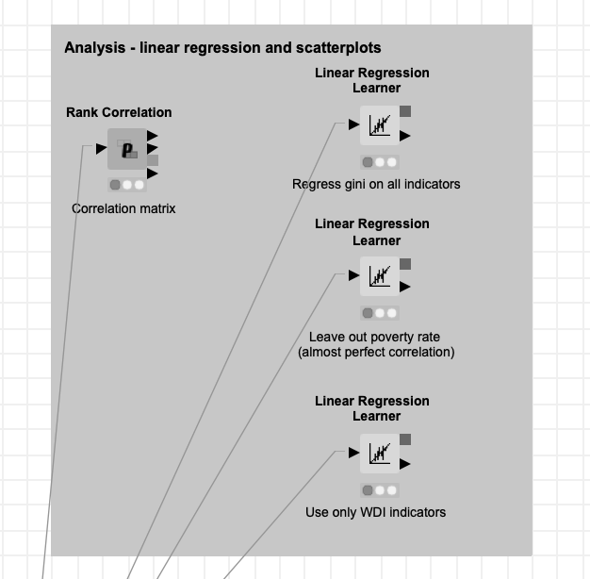
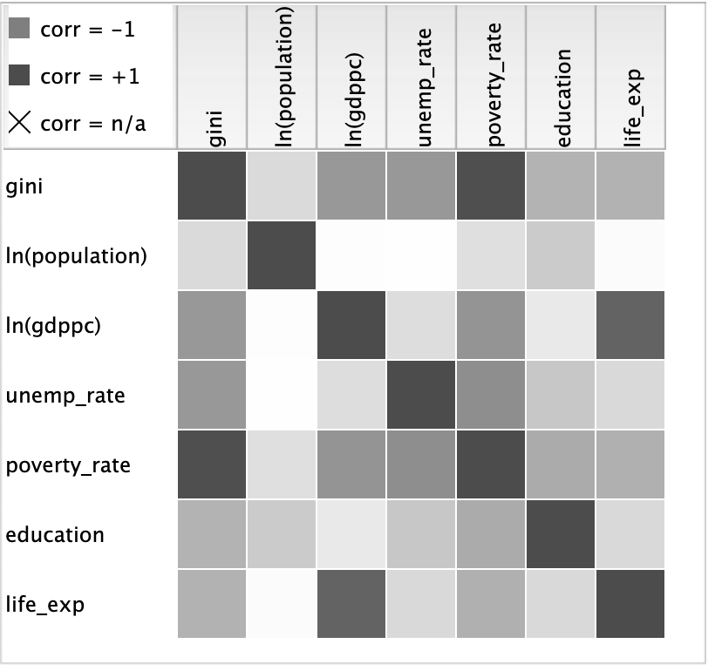
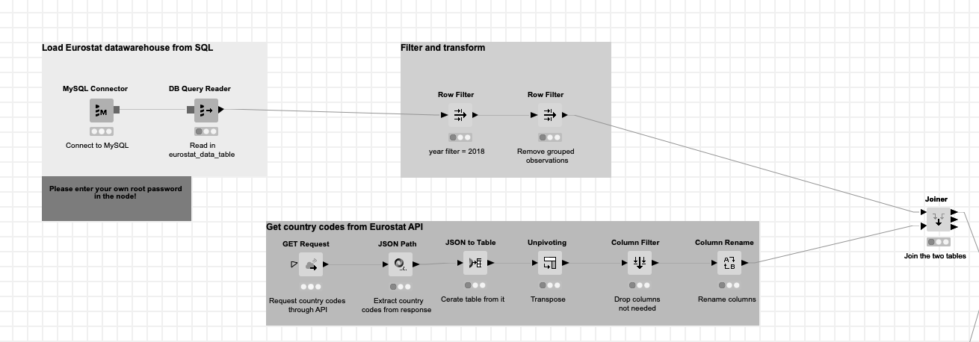
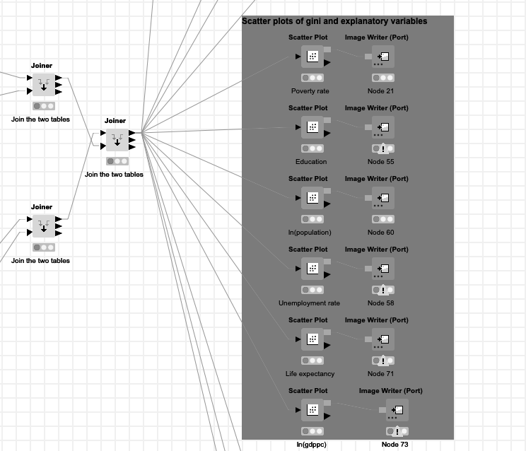
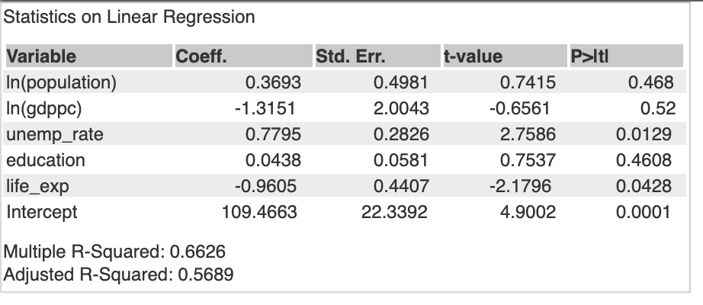
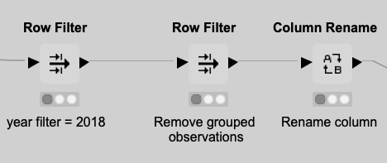
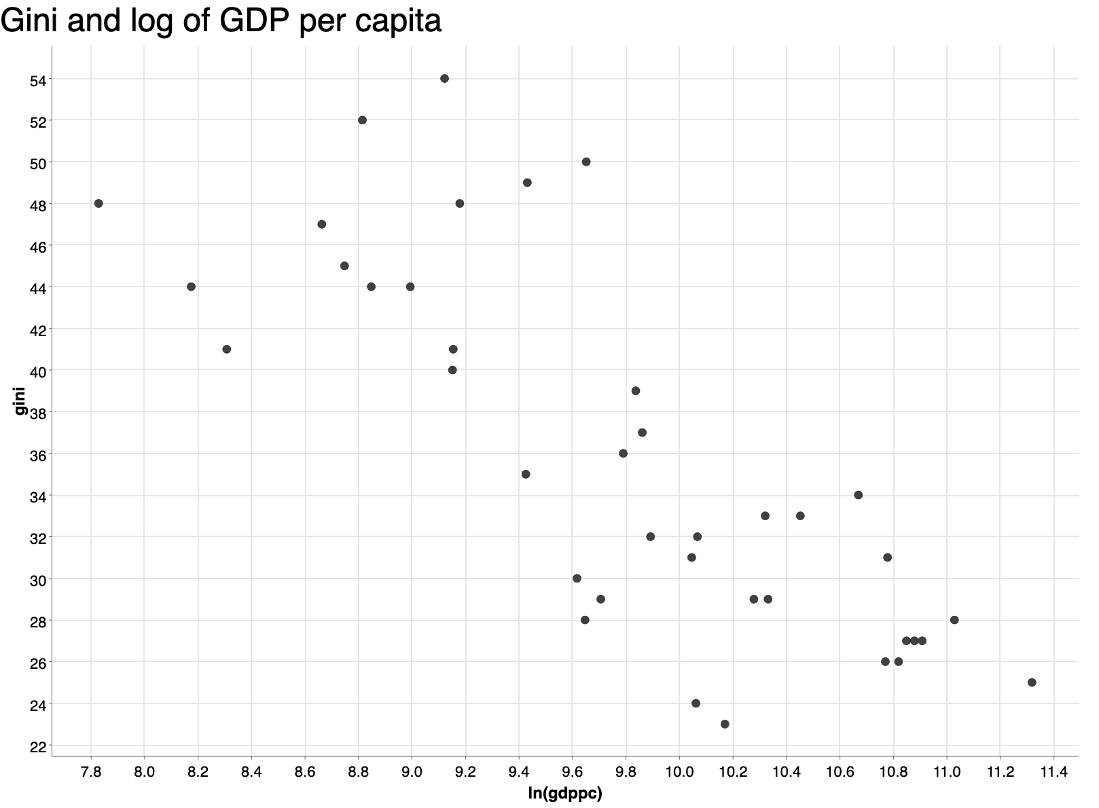
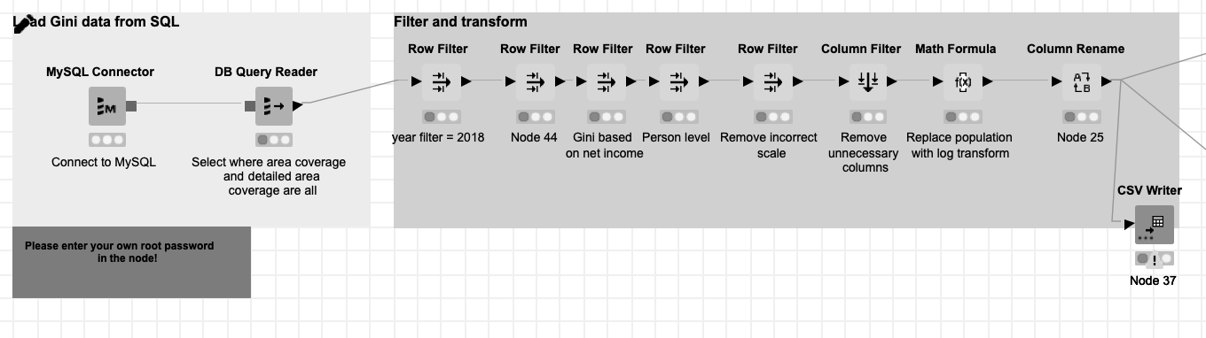
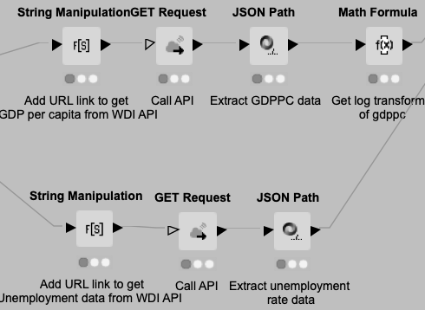
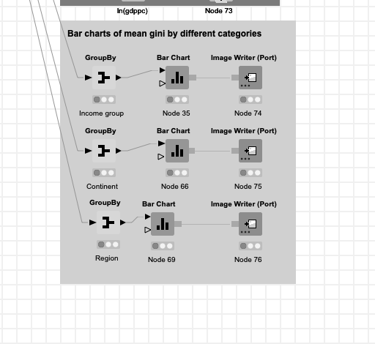
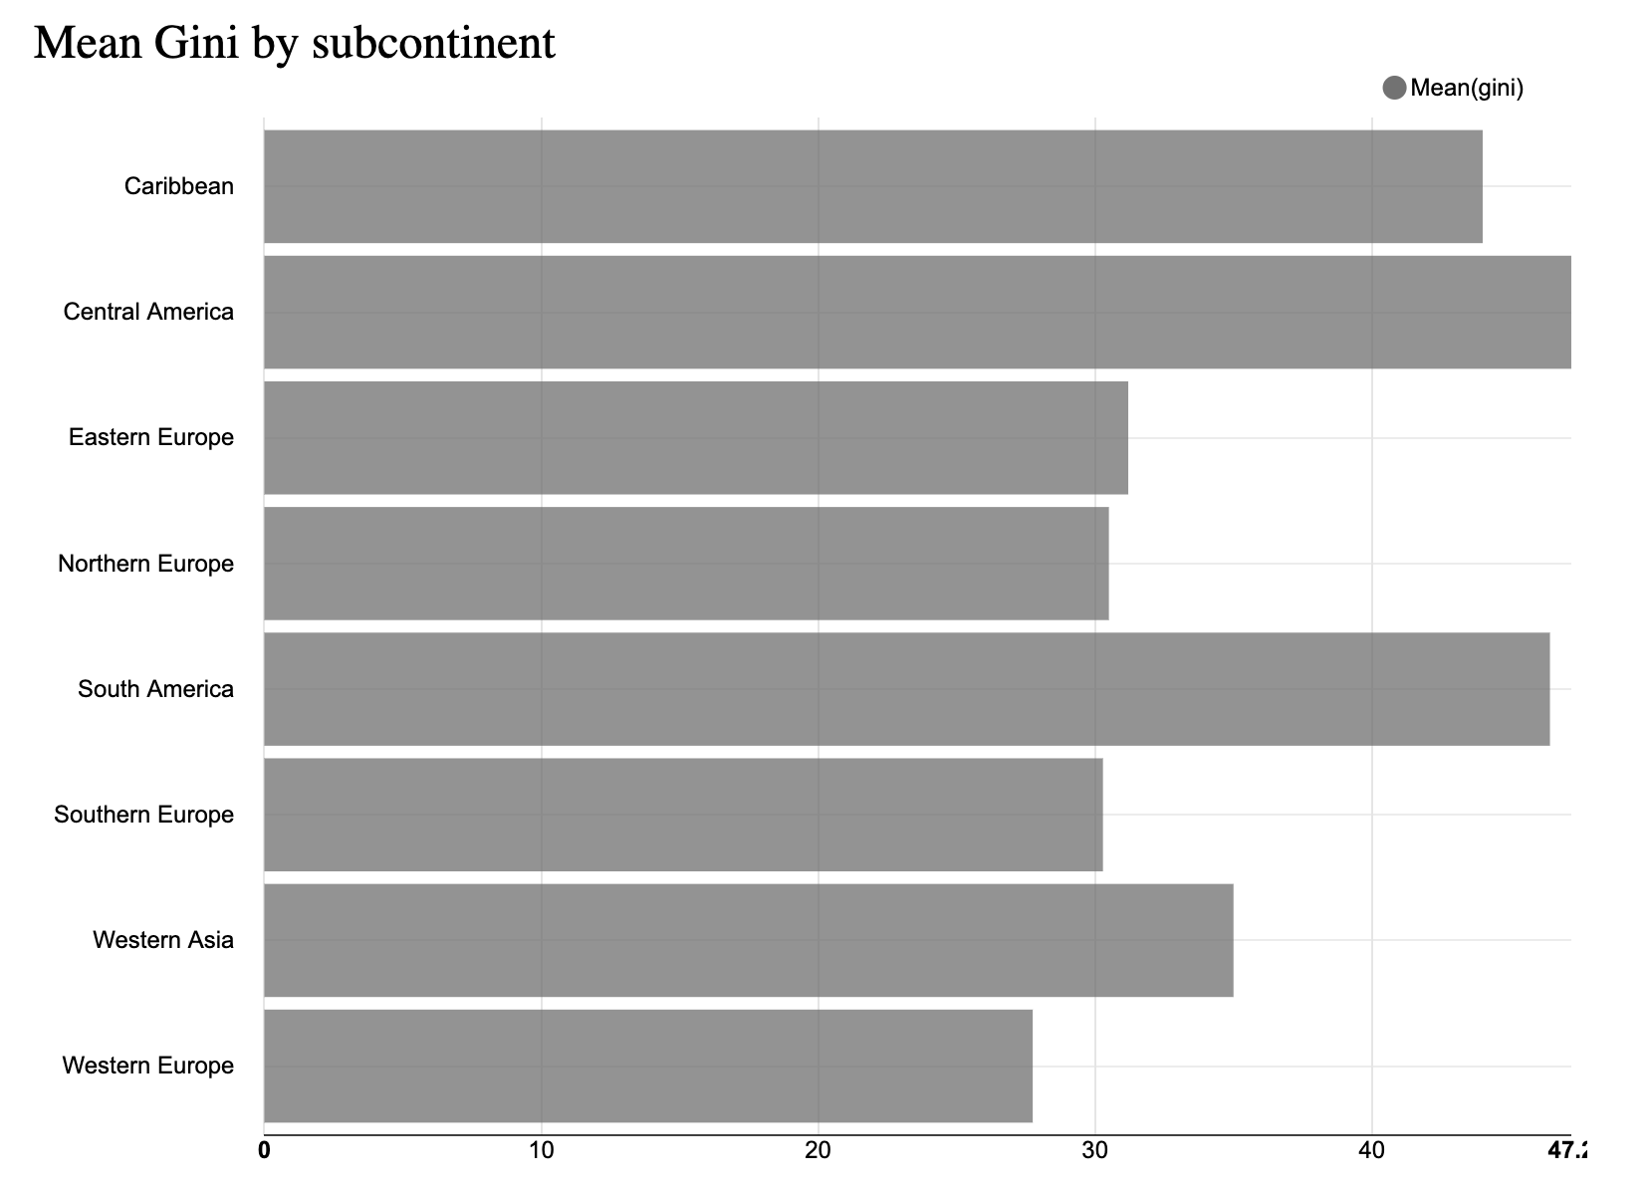
Data Workflow
paris
Raw data
Load Data
From SQL
Filter &
Transform
Get data
From API’s
Joins
Data Analysis
Data
Visualization
AP1 #1: Get Country Codes
From Eurostat API
Linear
Regression
Scatter Plots
Eurostat
data warehouse
Filter
2018
Education
Life Expectancy
Gini data
Remove
Incorrect scale
Unnecessary columns
Replace population
Poverty
AP1 #2: Get GDP &
Unemployment from WDI API
Gini
Bar Graphs

Slide 5

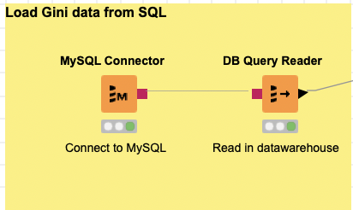
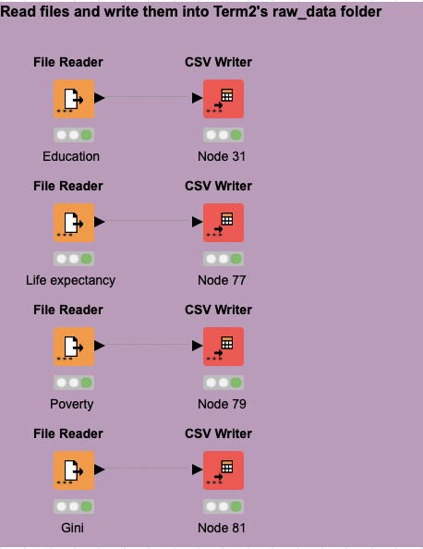
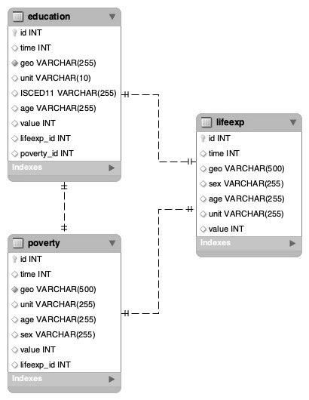
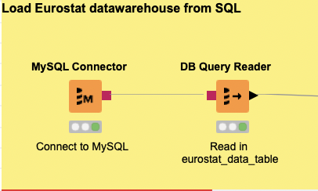
Data Collection - SQL
paris
Read file & write into folder for SQL data load
Via SQL
Load Gini data from MySQL
Download data from Kaggle and Eurostat
Load Eurostat from MySQL

Slide 6
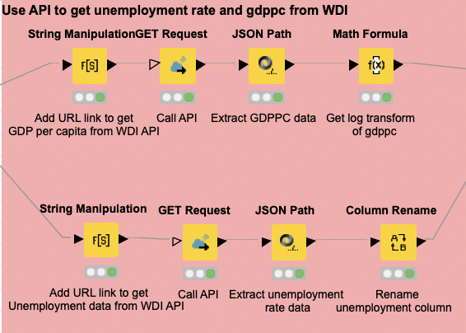
Data Collection
paris
Use ISO3 country codes to get data from the Worldbank API
Unemployment and GDP per capita two indicators of interest
From JSON files the values needed were put into a column of the dataframe
API#1: Get unemployment rate & GDPPC from WDI
Via API #1

Slide 7

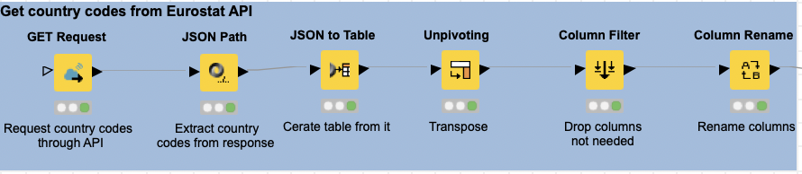
Data Collection
paris
Country codes needed for the Eurostat data to be able to merge – ISO2 available through API
Eurostat query builder and postman used for it
Returns with JSON - needed to extract codes, transformed to table and added as column
Via API #2
API#2: Get country codes from Eurostat API

Slide 8
OUR PROCESSES
paris

Slide 9
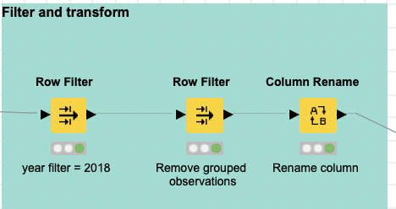
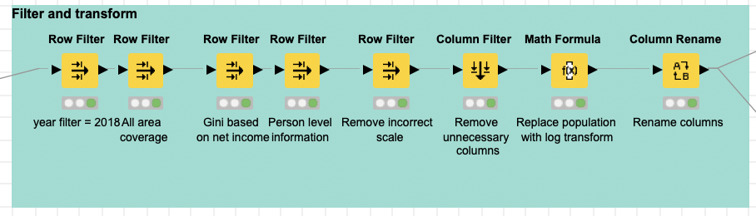
Data Filtering and transformation
paris
Filter on only 2018
Remove grouped observations
Rename columns to standard
Filter on only 2018 data
Get full coverage of countries e.g. no rural/urban separately
Gini calculation based on net income
Remove observation with incorrect scale
Drop unnecessary columns
Log transform population and rename columns
Eurostat
Kaggle data

Slide 10
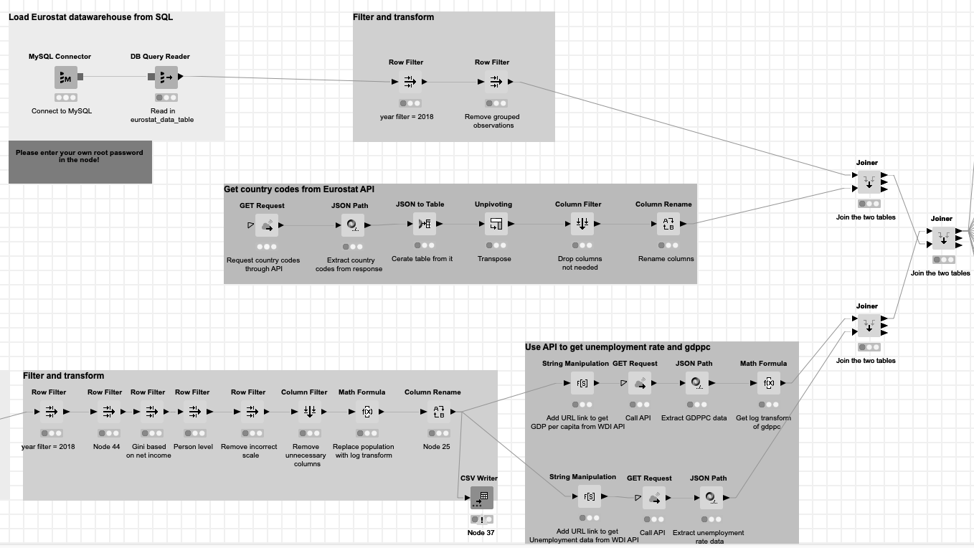
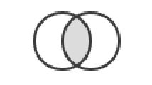

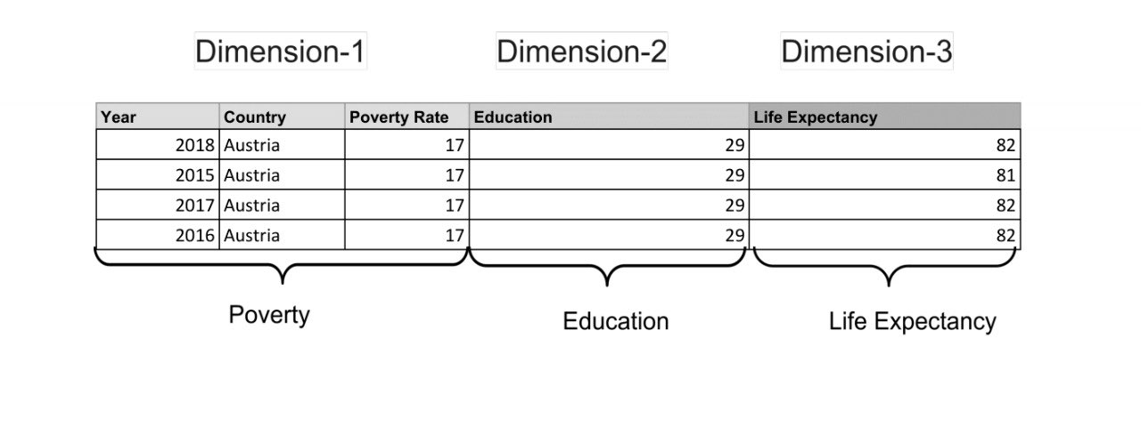
Data Joining
paris
GDP
from WDI API
Unemployment
from WDI API
Country Codes
from Eurostat API
Eurostat DW
from SQL
Inner Join
Using the 3 letter country code
Left Outer Join
Left Outer Join
Final Table

Slide 11
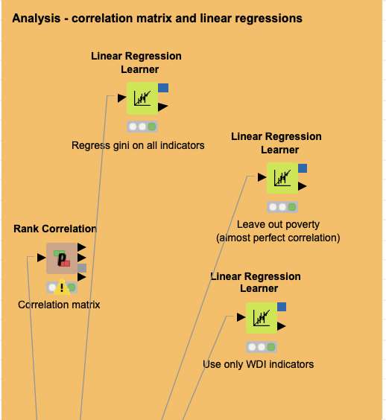
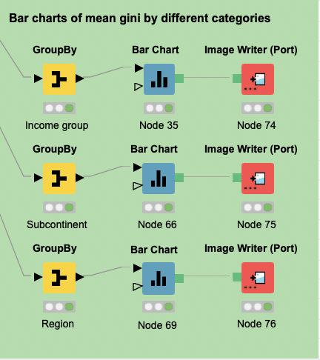
Data Analysis
paris
Analysis - Linear Regression
Analysis - Scatter Plots
Analysis - Bar Charts

Slide 12
OUR RESULTS
paris

Slide 13
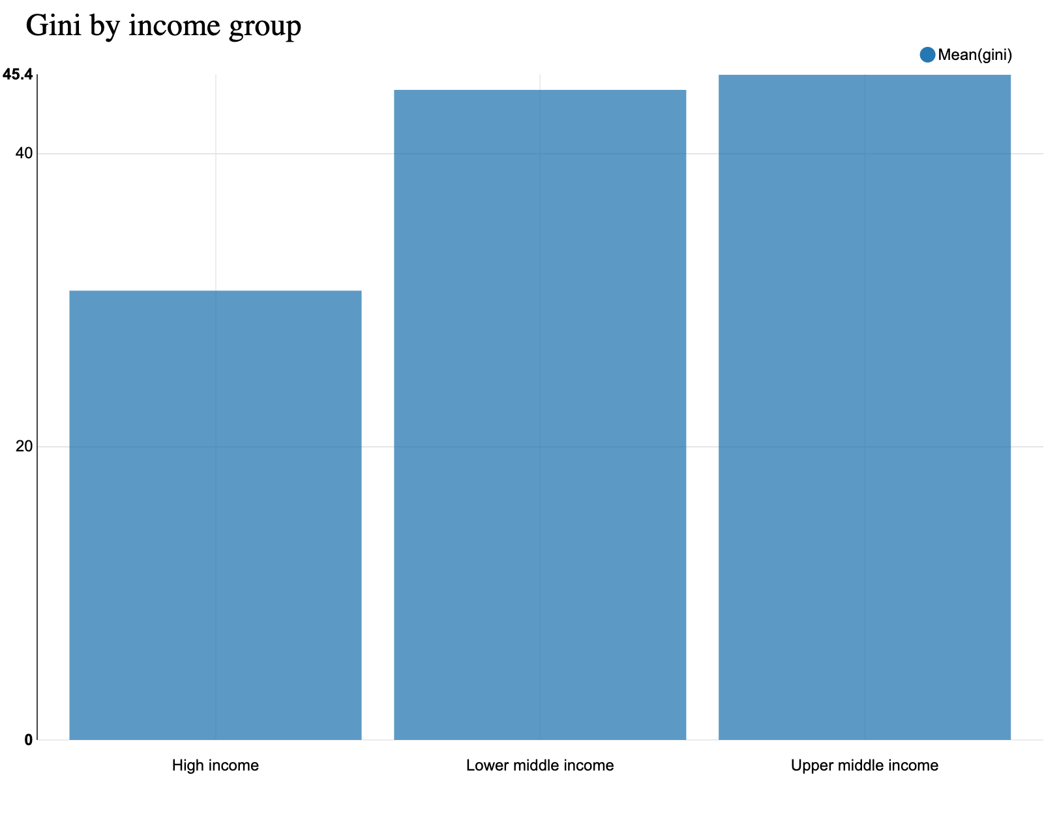
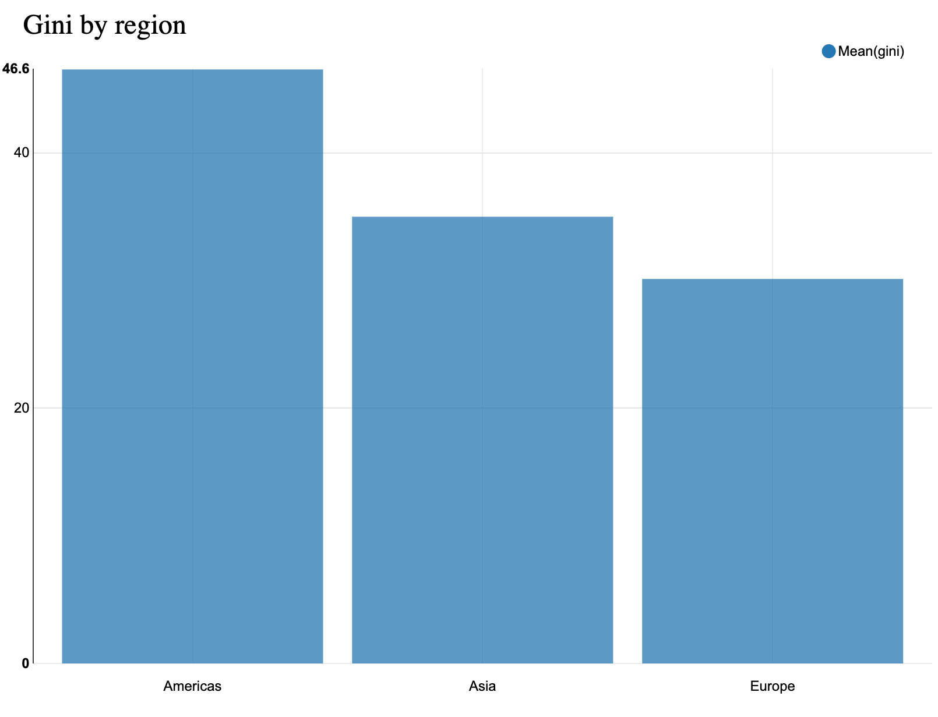
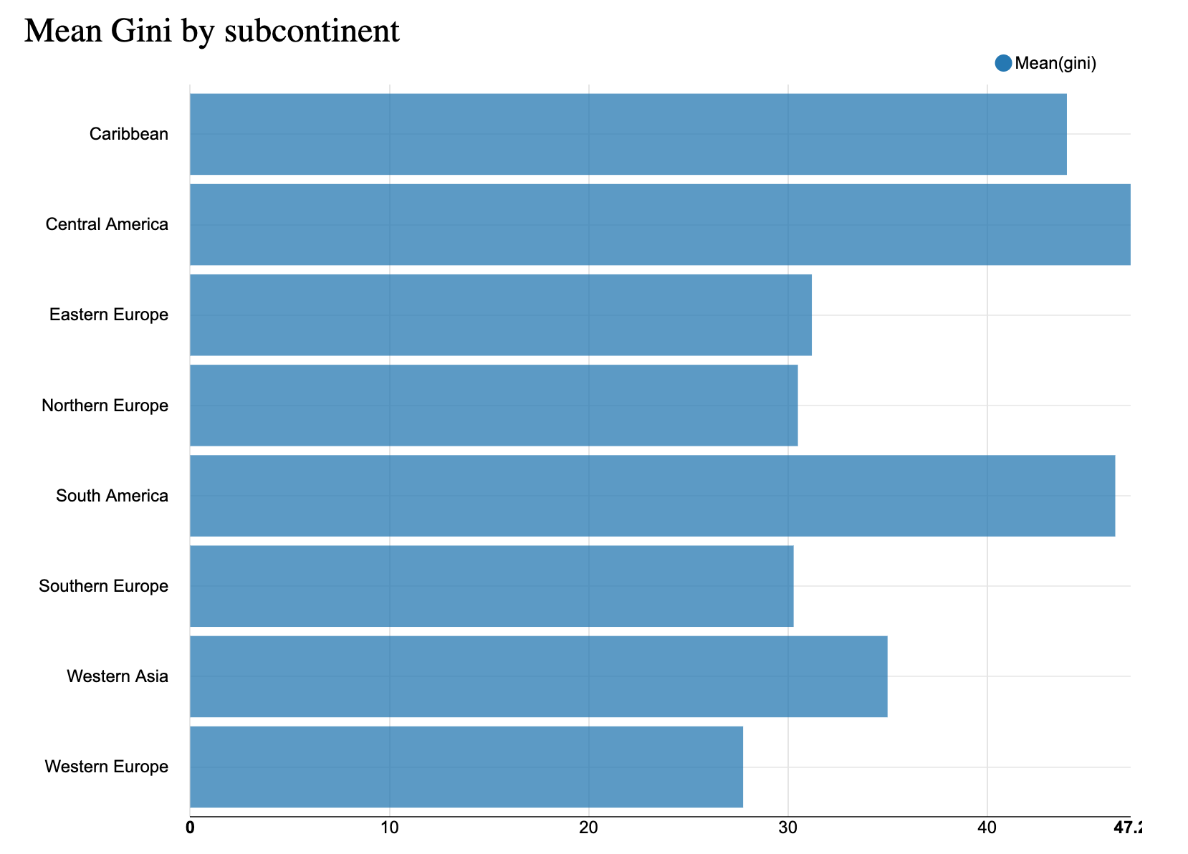
Bar charts
paris
Gini by Region
Gini by Income Group
Mean Gini by Subcontinent
We find that:
Among greater regions (continents), the countries of Europe are the least inequal, Asia comes second
Higher income countries tend to be less inequal - social security could be key
Among subcontinents, Central America is the least, while Western Europe is the most equal in terms of income distribution

Slide 14
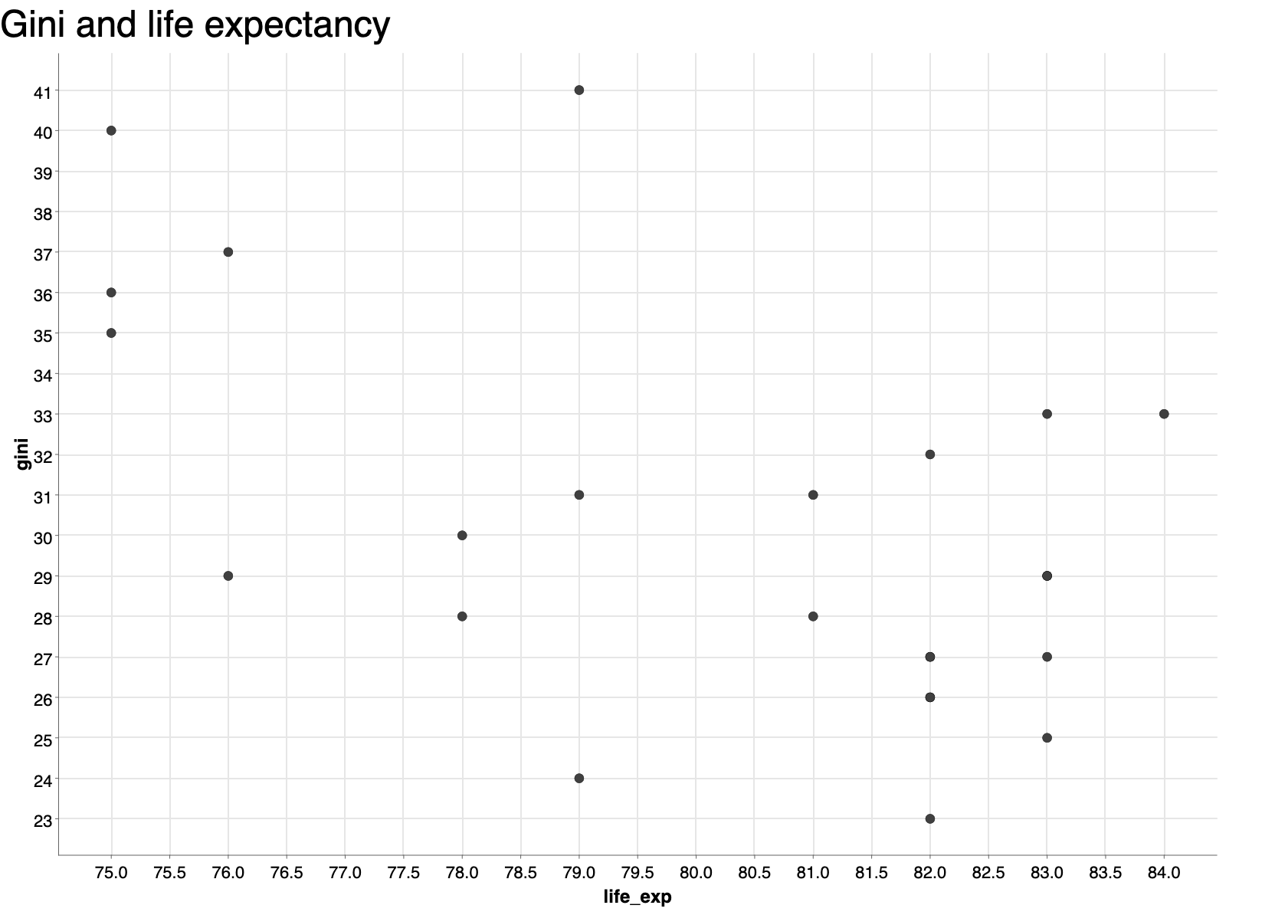
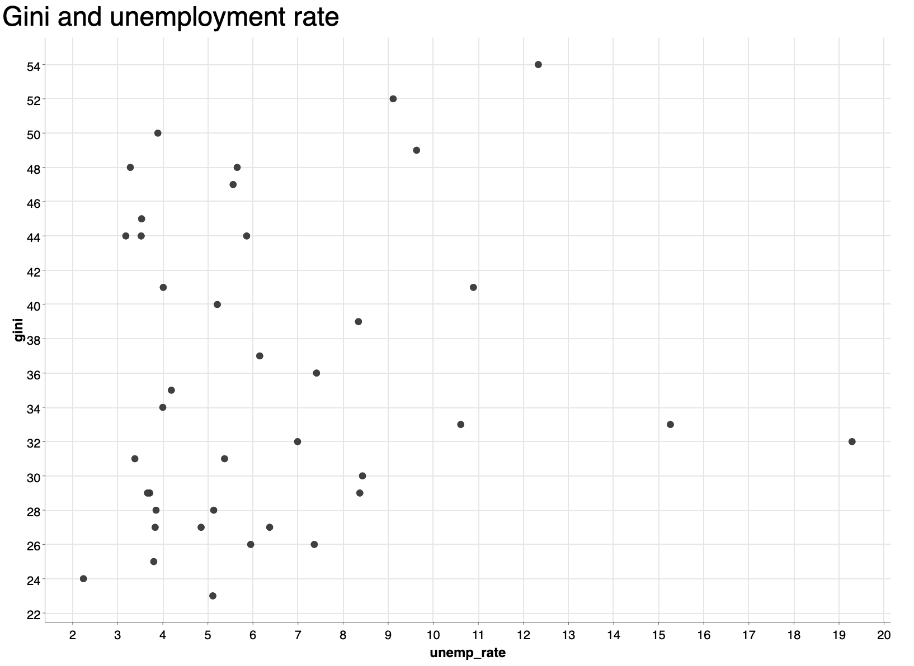
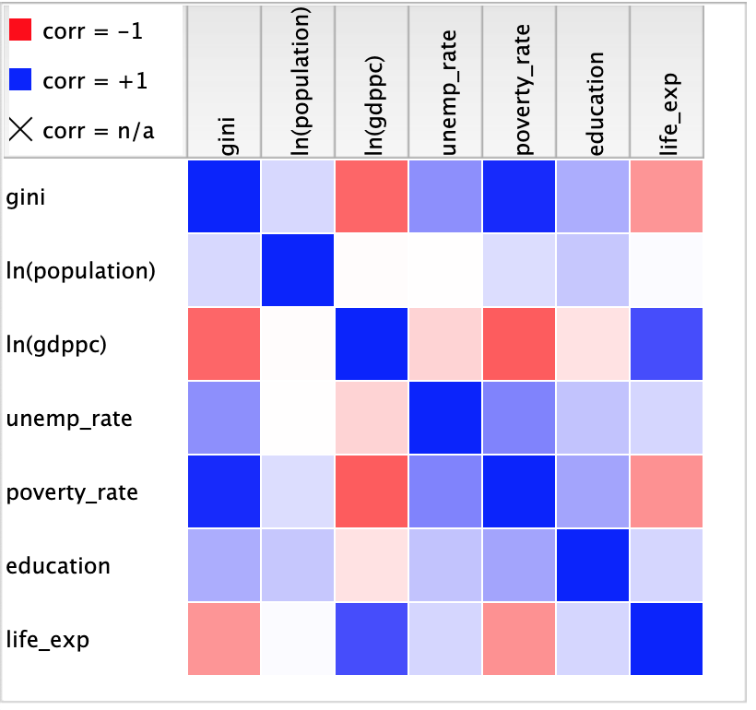
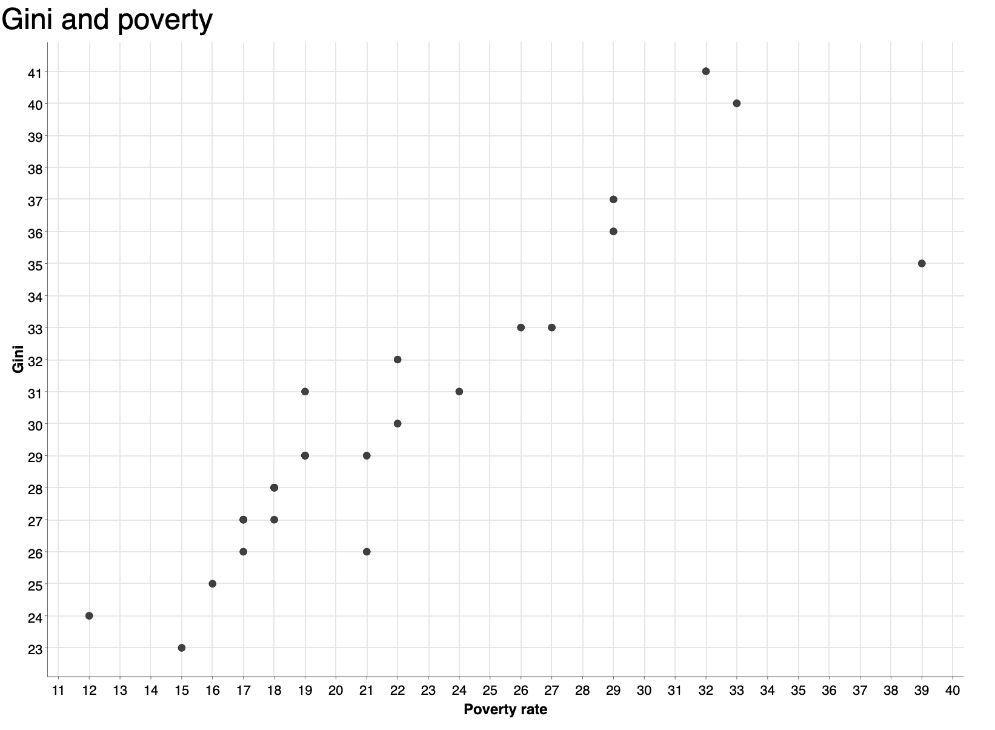
Scatter plots and correlation matrix
paris
Gini & Life Expectancy
Gini & Unemployment Rate
Gini & Education
Gini & Log GDP per capita
Gini & Poverty
We find that:
Poverty is extremely positively correlated with Gini
Life expectancy and GDP per Capita are negatively correlated with it
Unemployment rate is somewhat positively correlated

Slide 15
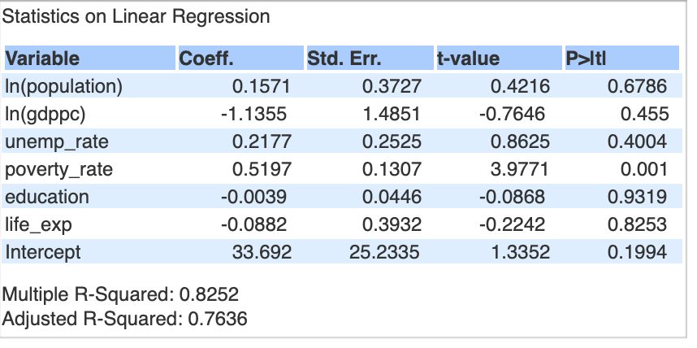
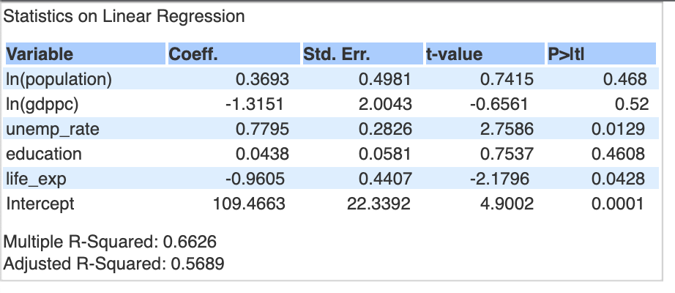
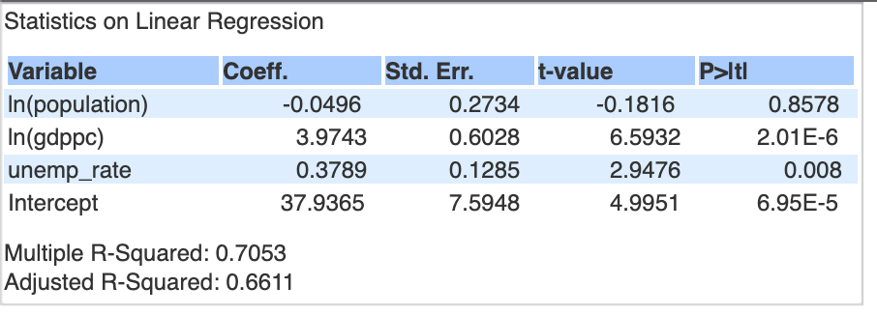
Regression Results
paris
All indicators
Without poverty
Only WDI indicators (not only European countries)
We find that:
This regression contains only indicators that are available for all countries in our sample (no Eurostat data)
In this regression, GDP per Capita and unemployment rate are significant
Both are positively associated with the gini coefficient
This model explains around 70% of the variance in income inequality across countries
We find that:
Only the coefficient of the poverty indicator is statistically significant – it is significant at very low significance level
So correlated with gini it takes away significance of other variables
Model explains 82% of the variance in gini
We find that:
Unemployment rate and life expectancy are now statistically significant at 5% level
Higher unemployment rate is associated with higher gini, while the opposite is true for life expectancy
This model has a lower R-squared of 66%

Slide 16
Take aways
Higher income countries and European countries have lower income inequality
Poverty rate is extremely correlated with income inequality
Unemployment rate and life expectancy can also have also a significant effect

